Slide 1
Impact of Buzz Words in 10-k Filings
Gagandeep Khanuja
Swapnil Rai
KRANNERT SCHOOL OF MANAGEMENT

Slide 2
PROBLEM STATEMENT
A mutual fund manager is interested to analyze the impact of buzz words ( e.g. Machine Learning, predictive modeling ) in 10-K filings on industry. Help him analyze and answer the following questions
How does the mention of cutting edge technology ( e.g. Big Data, Cloud Computing, AI ) in 10-K filings associate with the way a firm performs in the future?
How prevalent are these types of mentions?
Is there a variation across industries?
Are mutual fund managers decisions affected by such 10-K filings?
KRANNERT SCHOOL OF MANAGEMENT

Slide 3
DATA SOURCES
The data has been scraped from the web in the following order:
List of S&P 500 companies – Wikipedia
Extraction of 10-K filings for S&P 500 companies – Edgar
Financial information for S&P 500 companies (Profit, Stock Price and Return on Equity for last 3 years) – Bloomberg
Extraction of one thousand randomly chosen 13F-HR (Mutual Funds) - Edgar
KRANNERT SCHOOL OF MANAGEMENT

Slide 4
METHODOLOGY
SCRAPING 10-K FORMS
(3 years)
*WORD CLOUD
TREE MAP
HOMOGENITY TEST,
LINEAR REGRESSION
LOOK UP DICTIONARY
SCRAPING FINANCIAL DATA
PRICE, PROFIT, ROE
STATISTICAL ANALYSIS *
SHARES
SCRAPING 13-F
MEASURING PREVALENCY
MEASURING VARIATION
DECISION MAKING BY THE MANAGER

Slide 5
DICTIONARY OF WORDS
Terms related to : Analytics | Terms related to : Data | Terms related to : Cloud | Terms related to : Machine Learning
Predictive Analytics | Data Mining | Cloud Computing | Hadoop
Business Analytics | Data Security | Private Cloud | Optimization
Customer Analytics | Data Center | Hybrid Cloud | Intelligent System
 | Data Warehousing | Internet of Things | Augmented Reality
 | Data Science | Industrial Internet of Things | Artificial Intelligence
 | Big Data |  | Virtual Reality
 | Data Streaming
 | Data Processing
KRANNERT SCHOOL OF MANAGEMENT

Slide 6
IMPACT oF BUZZWORDS on FUTURE Financial Performace
KRANNERT SCHOOL OF MANAGEMENT

Slide 7
METHODOLOGY
A look up table of 35 keywords has been prepared and frequency/occurrence of these keywords is looked up in the 10-K files and stored separately.
Three regression models have been made with dependent variables (%Price change, %Profit change and %ROE change).
We have prepared an interaction term of industry and words to evaluate the significance of these words across industries.
On performing Regression test we are able to evaluate significance of individual industries, words and their combined affects to evaluate future financial performance.
Note: Level of Significance = 20%
KRANNERT SCHOOL OF MANAGEMENT

Slide 8
REGRESSION OUTPUT
%Price_Change= B₀ +B₁*(Industry₁)+B₂*(Word₁) +B₃*(Industry₁*Word₁)
 | Variable | Estimate | Pr(>|t|)
Industries | Real Estate | 0.1 | 0.12
 | Utilities | 0.16 | 0.03
 | Industrials | 0.19 | 0.01
 | Information Technology | 0.24 | 0.00
 | Material | 0.20 | 0.02
Words | Business Analytics | -1.73 | 0.02
 | Virtual Reality | 0.49 | 0.00
 | Data Science | -0.40 | 0.03
 | Hadoop | -5.81 | 0.00
 | Platform as a Service | 1.77 | 0.00
 | Infrastructure as a Service | -0.47 | 0.05
 | Data Center | -0.11 | 0.13
 | Natural Language Processing | -0.66 | 0.02
 | Intelligent System | 0.67 | 0.01
 | Cloud | 0.13 | 0.04
Note: Level of Significance = 20%
KRANNERT SCHOOL OF MANAGEMENT

Slide 9
INTERPRETING THE RESULTS
Impact of ‘Cloud Computing’ on Price Variation across industries
Information Technology has highest impact on Pricing across Industries. This is corroborated by positive interaction impact observed across significant words
Variable | Estimate | Pr(>|t|)
Materials*Cloud Computing | 0.36 | 0.16
Utilities*Cloud Computing | 0.28 | 0.16
Financial*Cloud Computing | 0.27 | 0.07
Consumer Staples*Cloud Computing | 0.26 | 0.13
Industrials*Cloud Computing | 0.24 | 0.11
Information Technology*Cloud Computing | 0.23 | 0.03
Health Care*Cloud Computing | 0.22 | 0.07
Variable | Estimate | Pr(>|t|)
Information Technology | 0.24 | 0.00
Information Technology*Virtualization Technology | 0.42 | 0.00
Information Technology*Business Analytics | 4.39 | 0.00
Information Technology*Business Intelligence | 1.26 | 0.00
Information Technology*Cloud Computing | 0.23 | 0.03
KRANNERT SCHOOL OF MANAGEMENT

Slide 10
ANALYZING PREVELANCE OF KEYWORDS
KRANNERT SCHOOL OF MANAGEMENT

Slide 11
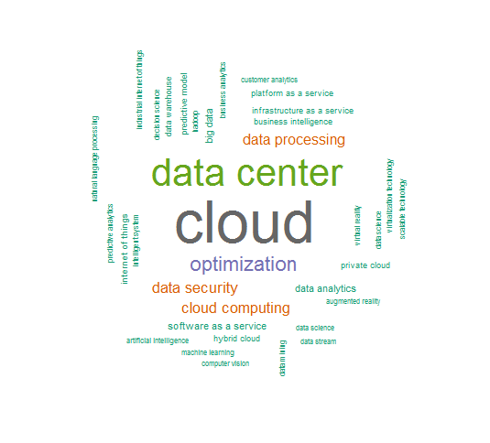
ANALYZING PREVELANCE OF DATA : WORD CLOUD
A word cloud has been deployed to visually represent the frequency of the keywords found in the 10-k filings. The importance of each tag has been shown with font size and color.
KRANNERT SCHOOL OF MANAGEMENT

Slide 12
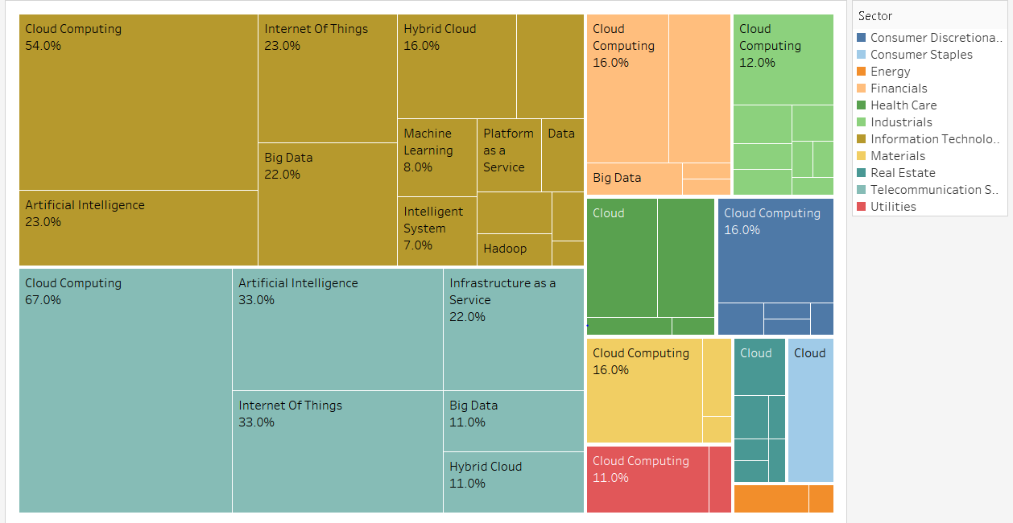
ANALYZING PREVELANCE OF DATA : TREE MAP
A tree map has been used to display the type of industry; each firm is associated with and frequency of the keywords under that industry as a percentage.
KRANNERT SCHOOL OF MANAGEMENT

Slide 13
TESTING VARIATION OF WORD DISTRIBUTION ACROSS INDUSTRIES
KRANNERT SCHOOL OF MANAGEMENT

Slide 14
MEASUREMENT OF HOMOGENIETY : CHI TEST
The following Hypothesis could be thought about in context with Homogeneity used for our analysis.
H0 :The proportion of companies having the words in the 10-K is independent of the industry.
Hα : The proportion of companies having the words in the 10-K is dependent on the industry.
Chi Square test | X-Squared | Df | P value
Big Data | 151.73 | 10 | 2.20E-16
Artificial Intelligence | 46.201 | 10 | 1.32E-06
Internet of Things | 255.53 | 10 | 2.20E-16
Business Analytics | 36.099 | 10 | 8.09E-05
Virtual Reality | 51.185 | 10 | 1.42E-07
Machine Learning | 89.532 | 10 | 6.63E-15​
Note: Level of Significance = 20%
KRANNERT SCHOOL OF MANAGEMENT

Slide 15
EFFECT ON MUTUAL FUND HOLDINGS
KRANNERT SCHOOL OF MANAGEMENT

Slide 16
MUTUAL FUND HOLDINGS ANALYSIS
Building onto our earlier analysis, we now evaluate the impact of these buzzwords on holding’s changes for these companies in mutual funds(% change in mutual fund shares).
We conduct a similar multiple regression with ‘%Mutual Fund Share change’ as the dependent variable.
On performing Regression, we are able to evaluate significance of individual industries, words and their combined affects to analyze mutual fund manager’s decision.
Note: Level of Significance = 20%
KRANNERT SCHOOL OF MANAGEMENT

Slide 17
REGRESSION OUTPUT
%Holdings_Change=B₀ +B₁*(Industry₁)+B₂*(Word₁) +B₃*(Industry₁*Word₁)
 | Variable | Estimate | Pr(>|t|)
Industries | Energy | 0.10 | 0.12
 | Financial | 0.16 | 0.03
Words | Predictive Model | 0.57 | 0.05
 | Software as a Service | 0.30 | 0.1
 | Cloud Computing | -0.08 | 0.19
 | Data Center | -0.09 | 0.19
 | Data Processing | 0.15 | 0.15
 | Intelligent System | -0.39 | 0.19
Note: Level of Significance = 20%
KRANNERT SCHOOL OF MANAGEMENT

Slide 18
INTERPRETING THE OUTPUT
Even within Information Technology, we see no impact of occurrence of buzzwords on mutual fund manager’s decision to buy holdings.
Variable | Estimate | Pr(>|t|)
Information Technology | 0.04 | 0.54
Information Technology*Virtualization Technology | -0.79 | 0.49
Information Technology*Business Analytics | -0.69 | 0.51
Information Technology*Business Intelligence | -0.1 | 0.81
Information Technology*Cloud Computing | 0.05 | 0.55
Note: Level of Significance = 20%
KRANNERT SCHOOL OF MANAGEMENT

Slide 19
CONCLUSION AND RECOMMENDATION
Words like cloud computing, optimization and data center are highly prevalent mentions in 10-Ks of S&P 500 companies. We observe a difference in prevalence of these words across industries.
Financial performance (in terms of Stock Prices) is positively affected by the occurrence of words like “Intelligent Systems” & “Cloud Computing”
The effect is further magnified in the sector of Information Technology.
However, Mutual Fund managers are not currently being affected by these words in their decisions to drop or buy the stocks of these S&P 500 companies.
Potential opportunity for the managers with access to our web scraping service to pick the stocks that are actually going to perform well in future.
KRANNERT SCHOOL OF MANAGEMENT

Slide 20
Thank You

